Slide 1
Chapter 2

Slide 2
Syllabus
Fundamentals of Digital Image and Spatial Domain Enhancement
2.1 Digital image Representation, Elements of digital image processing systems, sampling and quantization, basic relationships between pixels, mathematical operations on images.
2.2 Spatial domain enhancement techniques: Point processing, Neighborhood processing, spatial domain filtering, zooming.
2.3 Spatial enhancement: Global processing: Histogram Equalization.
Self-Learning Topic: Histogram specification

Slide 3
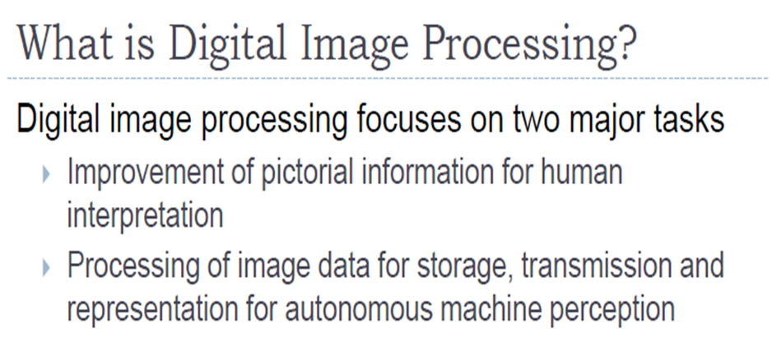

Slide 4
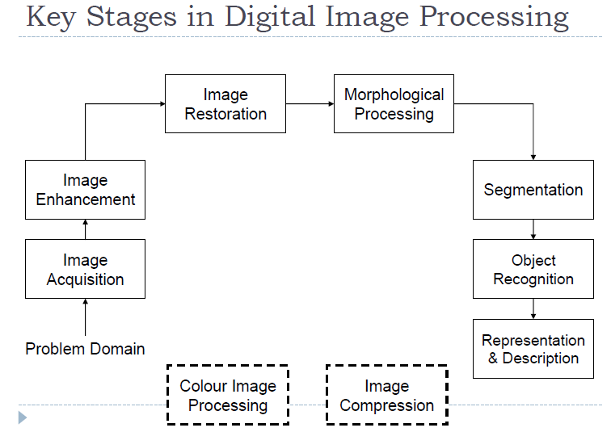

Slide 5
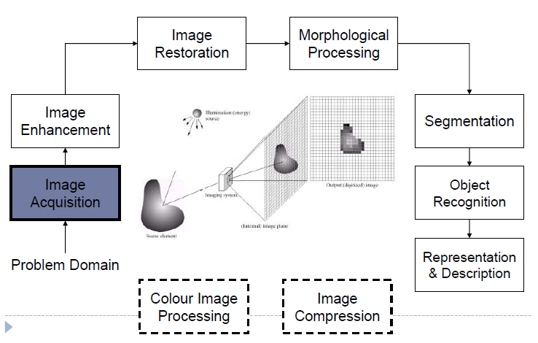

Slide 6
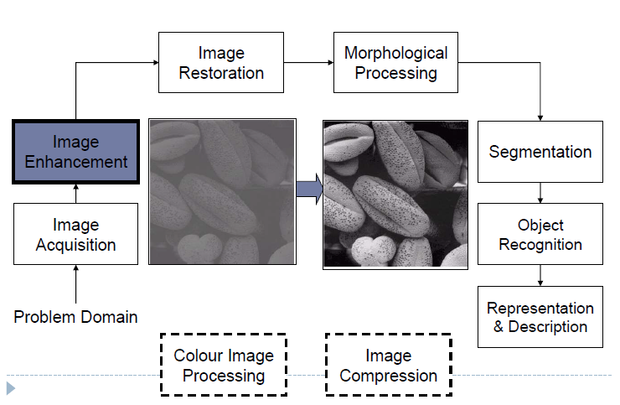

Slide 7
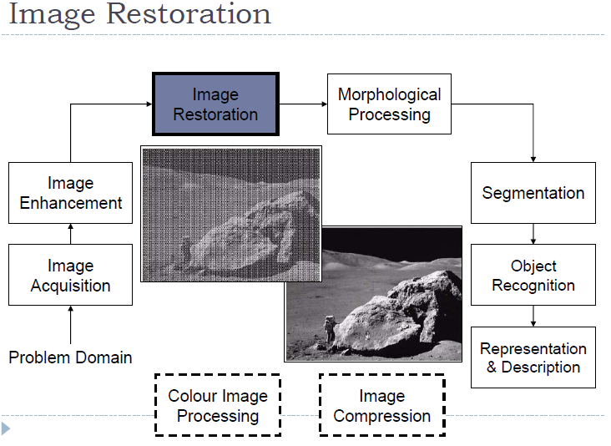

Slide 8
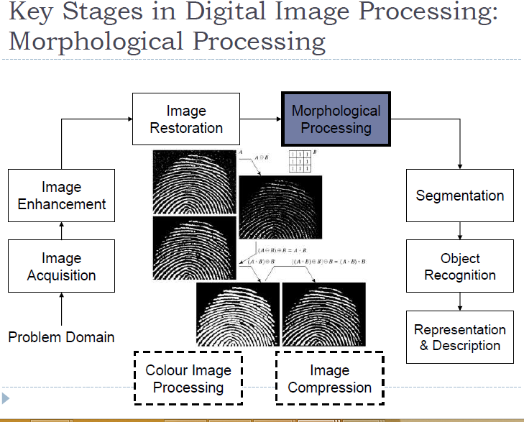

Slide 9
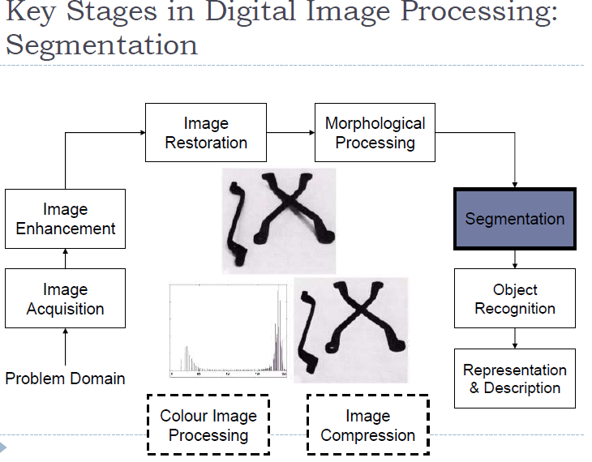

Slide 10
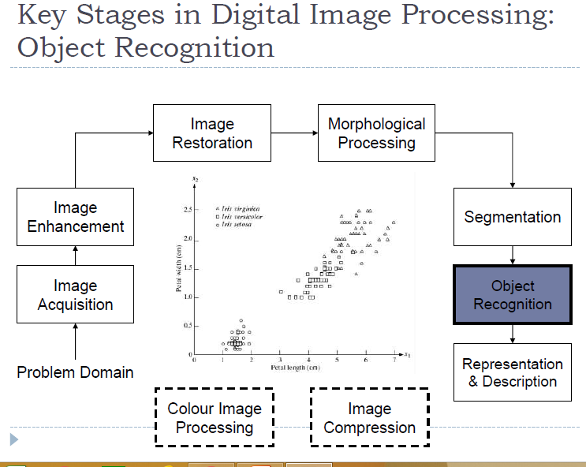

Slide 11
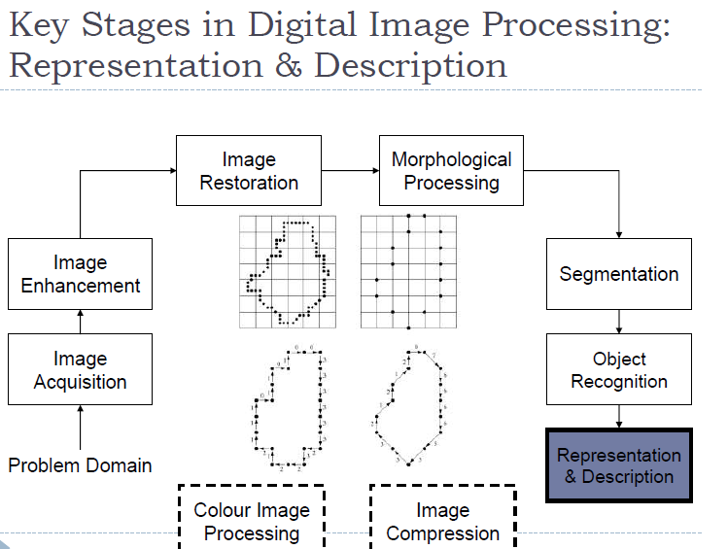

Slide 12
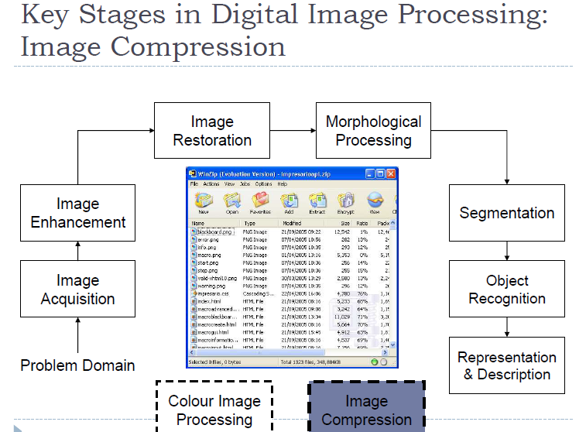

Slide 13
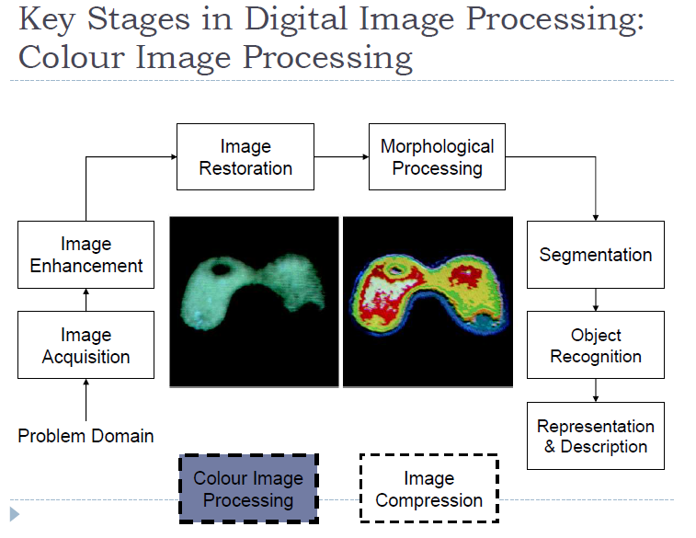

Slide 14
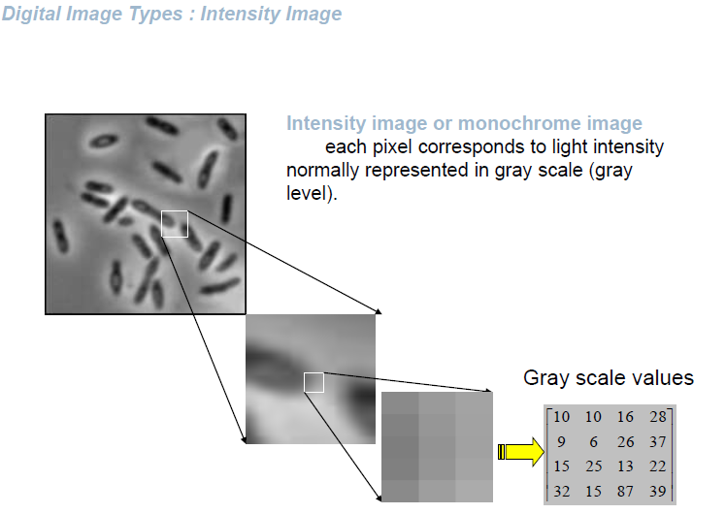

Slide 15
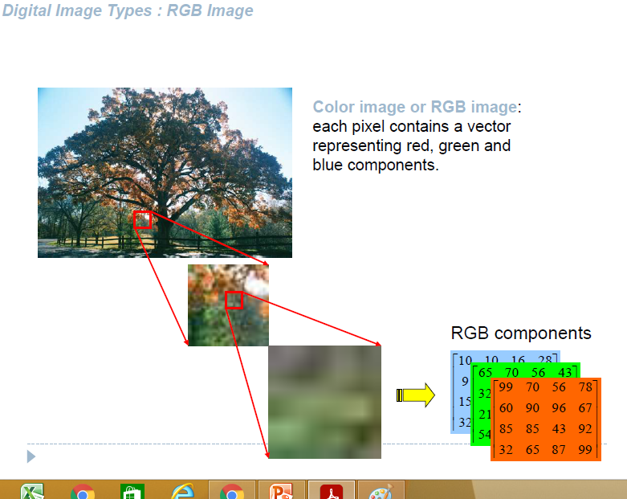

Slide 16
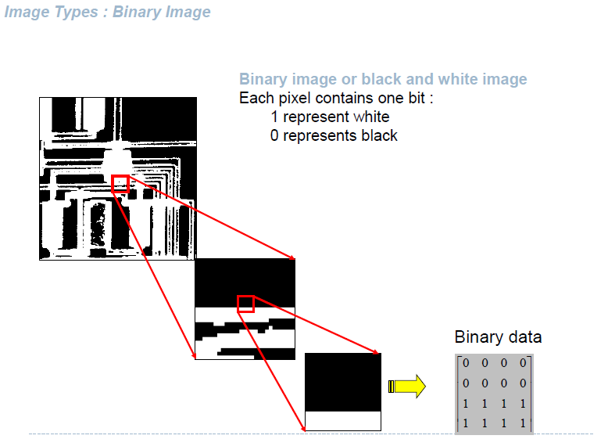

Slide 17
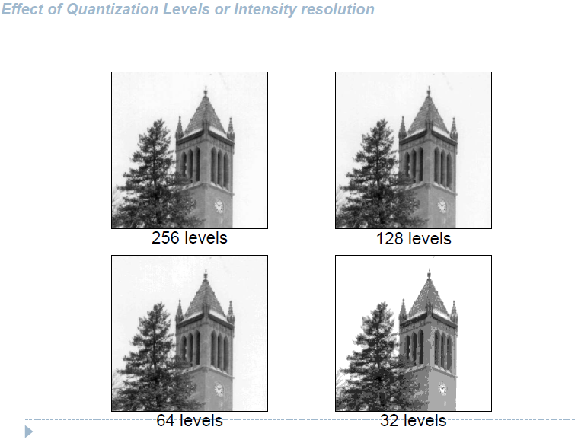

Slide 18
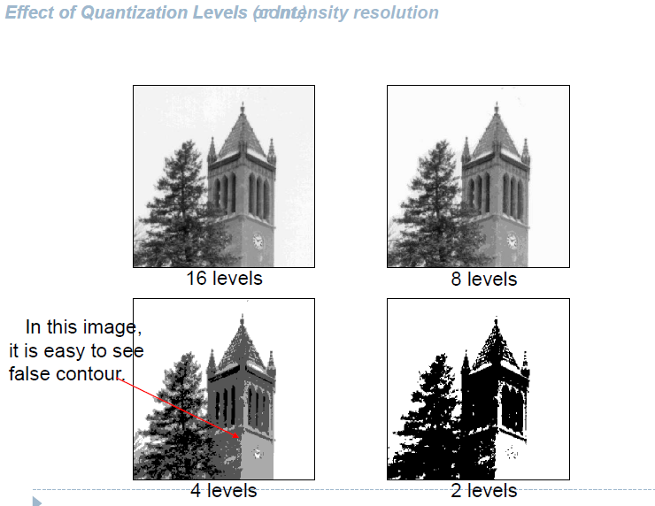

Slide 19

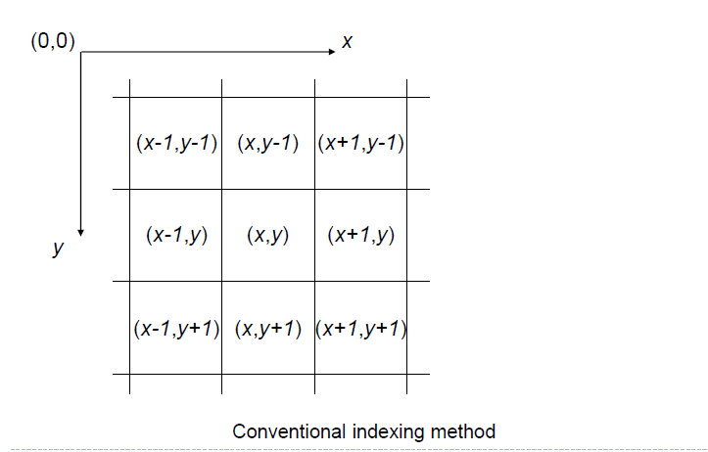

Slide 20
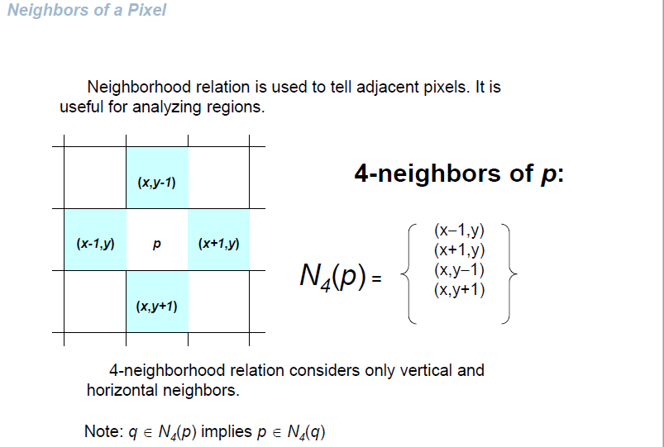

Slide 21
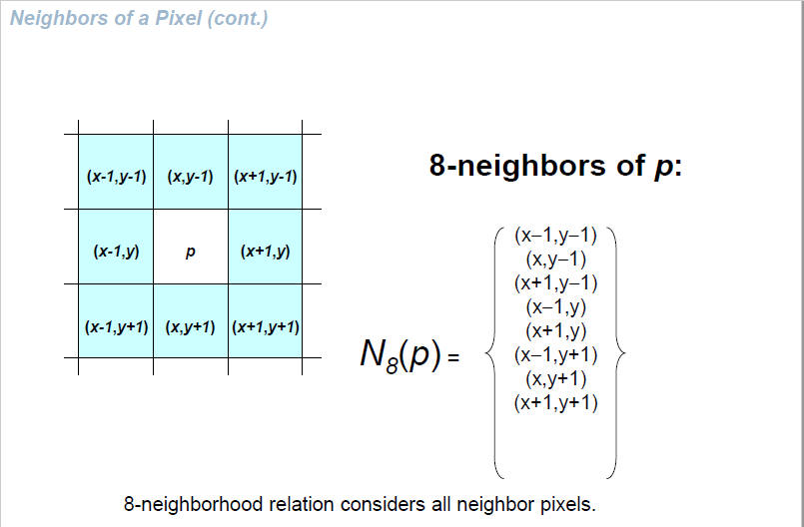

Slide 22
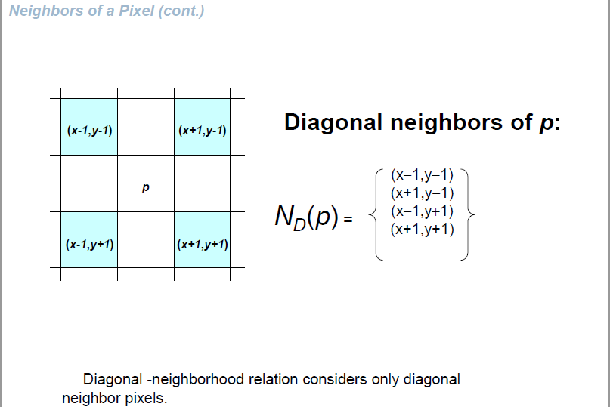

Slide 23
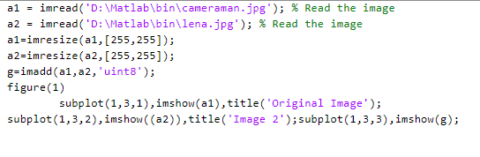
Mathematical Operations on Images
Image Addition

Slide 24
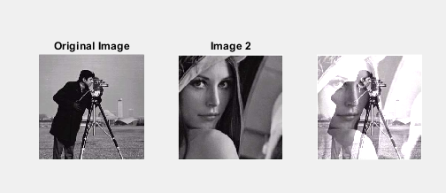

Slide 25
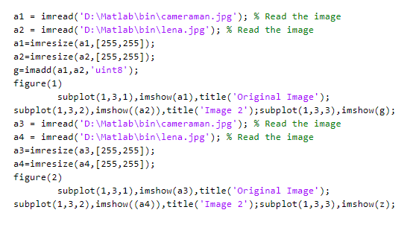
Image Subtraction

Slide 26
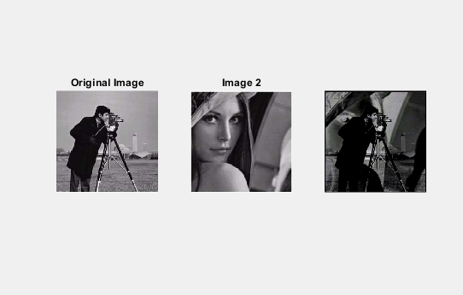

Slide 27
Mathematical Operations on Images
Image Multiplication
G(x,y)=f1(x,y)*f2(x,y)
Image Division
G(x,y)=f1(x,y)/f2(x,y)

Slide 28
Image Enhancement
objective of image enhancement is to improve the interpretability of the information present in images for human viewers.
enhancement algorithm is one that yields a better-quality image for the purpose of some particular application which can be done by either suppressing the noise or increasing the image contrast.

Slide 29
Spatial Domain Methods
Image-enhancement techniques can be classified into two broad categories as
spatial domain method
The spatial domain method operates directly on pixels or raw data.
(2) transform domain method
Transform domain method operates on the Fourier transform of an image and then transforms it back to the spatial domain.

Slide 30
Spatial Domain Methods
When the neighborhood is 1 x 1 then g depends only on the value of f at (x,y) and T becomes a gray-level transformation (or mapping) function:
s=T(r)
r,s: gray levels of f(x,y) and g(x,y) at (x,y)
Point processing techniques (e.g. contrast stretching, thresholding)

Slide 31
Enhancement by Point Processing
These are methods based only on the intensity of single pixels.
r denotes the pixel intensity before processing.
s denotes the pixel intensity after processing.

Slide 32
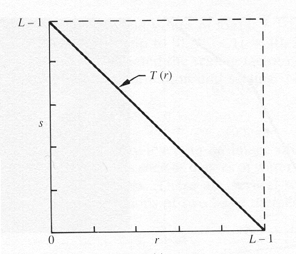
Image Negatives
Are obtained by using the transformation function s=T(r).
[0,L-1] the range of gray levels
S= L-1-r

Slide 33
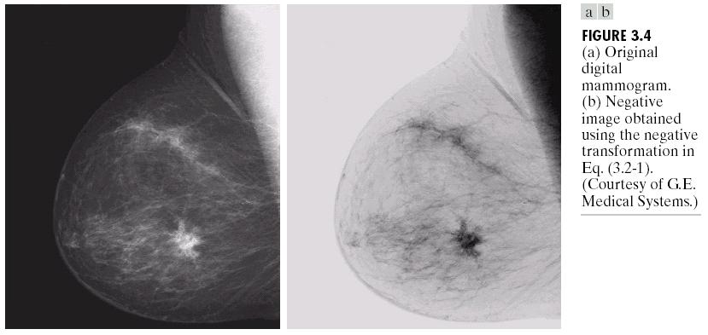
Image Enhancement in the
Spatial Domain

Slide 34
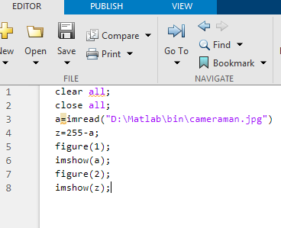

Slide 35
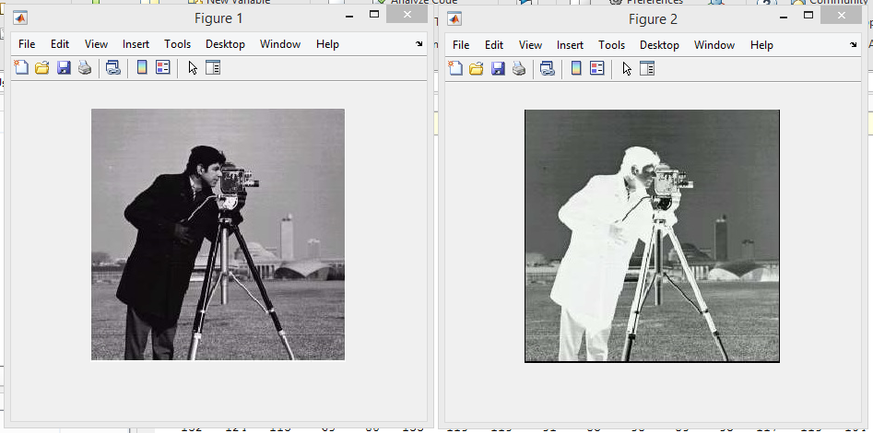

Slide 36
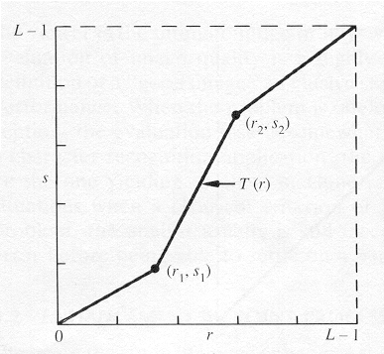
Piecewise-Linear Transformation Functions Contrast Stretching
To increase the dynamic range of the gray levels in the image being processed.

Slide 37
Contrast Stretching
The locations of (r₁,s₁) and (r₂,s₂) control the shape of the transformation function.
If r₁= s₁ and r₂= s₂ the transformation is a linear function and produces no changes.
If r₁=r₂, s₁=0 and s₂=L-1, the transformation becomes a thresholding function that creates a binary image.

Slide 38
Contrast Stretching
More on function shapes:
Intermediate values of (r₁,s₁) and (r₂,s₂) produce various degrees of spread in the gray levels of the output image, thus affecting its contrast.
Generally, r₁≤r₂ and s₁≤s₂ is assumed.

Slide 39
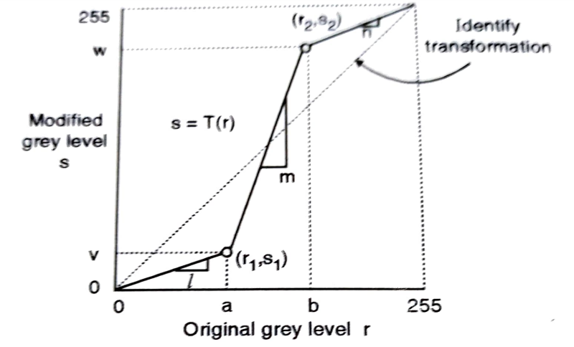
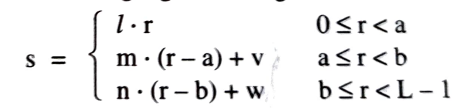

Slide 40
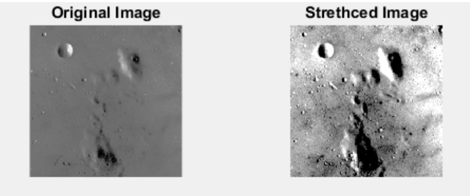

Slide 41
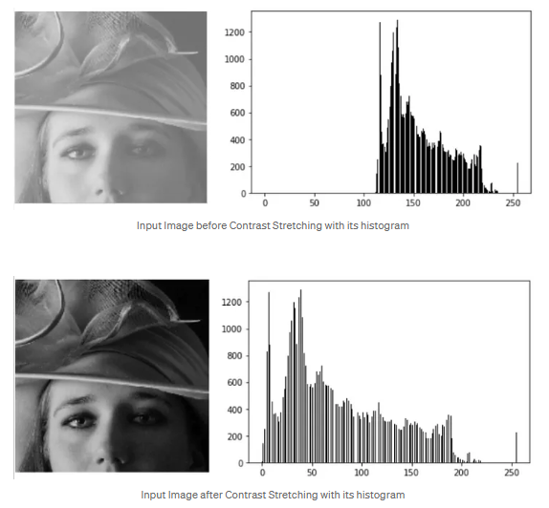

Slide 42
Spatial Domain - Point Processing
3) Thresholding
Extreme contrast stretching yields in thresholding.
S=255; if r(pixel intensity value) >=a (threshold value)
S=0 if r(pixel intensity value) < a(threshold value)

Slide 43
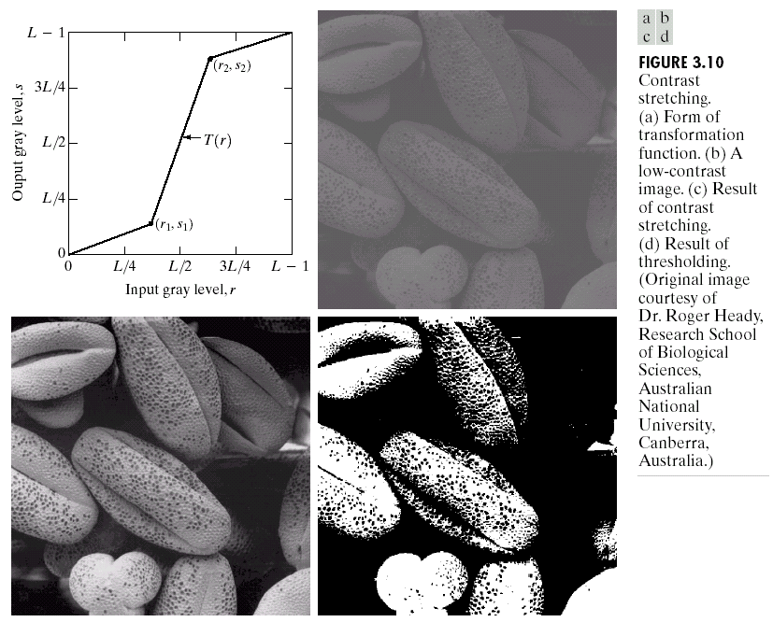
Image Enhancement in the
Spatial Domain

Slide 44
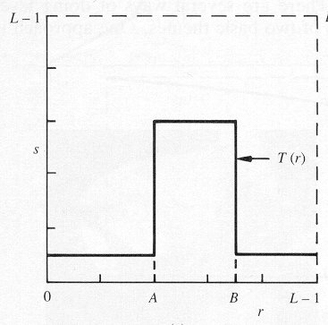
Gray-Level Slicing
To highlight a specific range of gray levels in an image (e.g. to enhance certain features).
One way is to display a high value for all gray levels in the range of interest and a low value for all other gray levels (binary image).

Slide 45
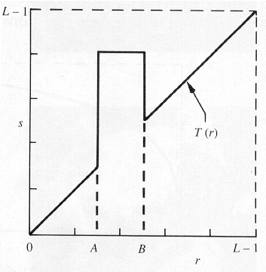
Gray-Level Slicing
The second approach is to brighten the desired range of gray levels but preserve the background and gray-level tonalities in the image:

Slide 46
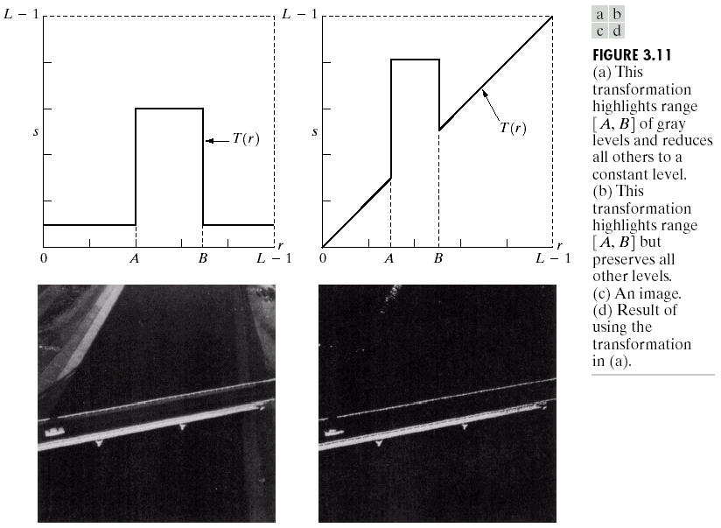
Image Enhancement in the
Spatial Domain

Slide 47
Bit-Plane Slicing
To highlight the contribution made to the total image appearance by specific bits.
i.e. Assuming that each pixel is represented by 8 bits, the image is composed of 8 1-bit planes.
Plane 0 contains the least significant bit and plane 7 contains the most significant bit.

Slide 48
Bit-Plane Slicing
More on bit planes:
Only the higher order bits (top four) contain visually significant data. The other bit planes contribute the more subtle details.
Plane 7 corresponds exactly with an image thresholded at gray level 128.

Slide 49
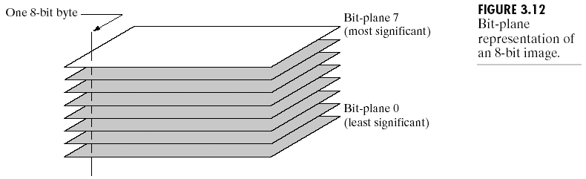
Image Enhancement in the
Spatial Domain

Slide 50
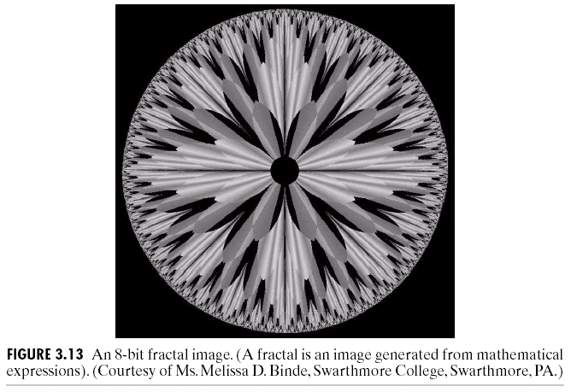
Image Enhancement in the
Spatial Domain

Slide 51
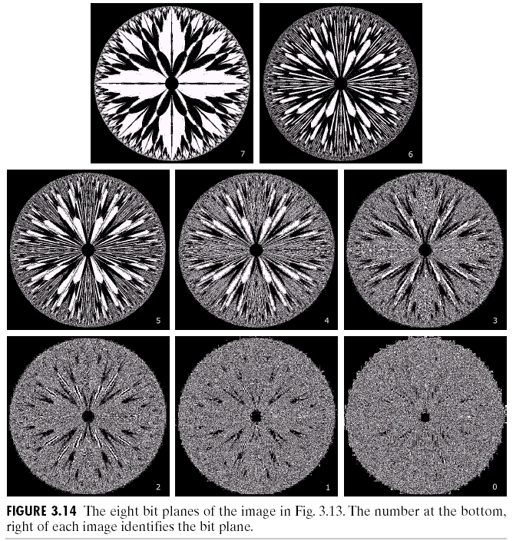
Image Enhancement in the
Spatial Domain

Slide 52
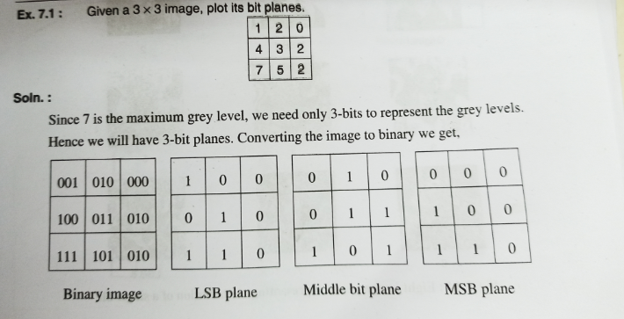
Spatial Domain - Point Processing

Slide 53
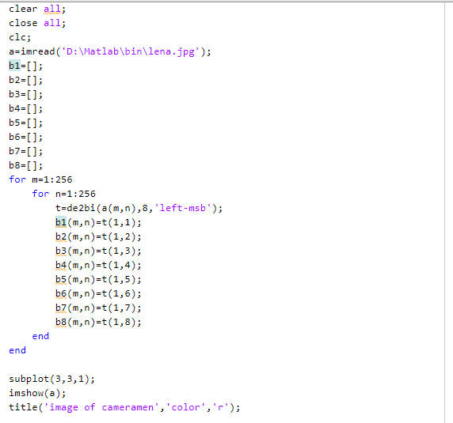

Slide 54
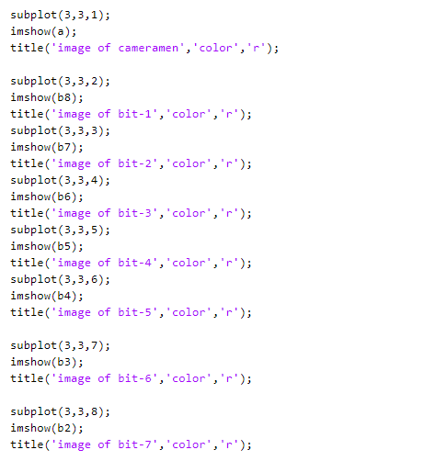

Slide 55
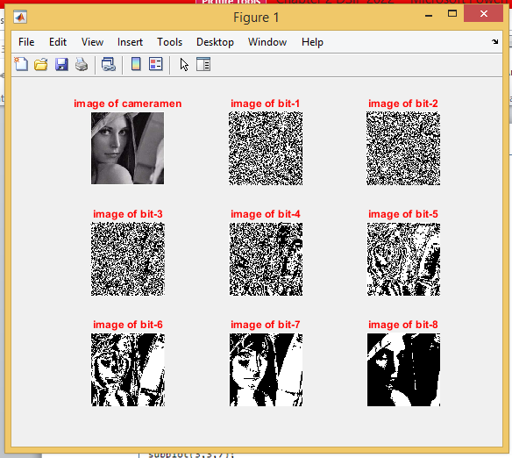

Slide 56
Spatial Domain - Point Processing
6) Dynamic Range Compression (Log Transformation)
Dynamic range of the image exceeds the capability of the display device.
Some pixel values are so high that low pixel values get over shadowed.
To be able to see the small value pixels dynamic range compression is used.

Slide 57
Spatial Domain - Point Processing
Log operator being the excellent compressing function.
Dynamic range compression is achieved by using log operator.
Log Transformation = C*log(1+|a|)…(a=image)

Slide 58
Log Transformations
s = c log(1+r)
c: constant
Compresses the dynamic range of images with large variations in pixel values

Slide 59
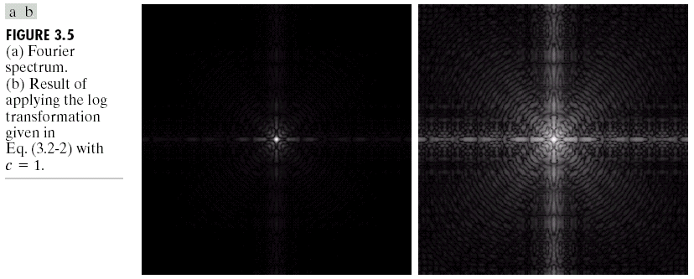
Image Enhancement in the
Spatial Domain

Slide 60
Power-Law Transformations
C, γ : positive constants
Gamma correction

Slide 61
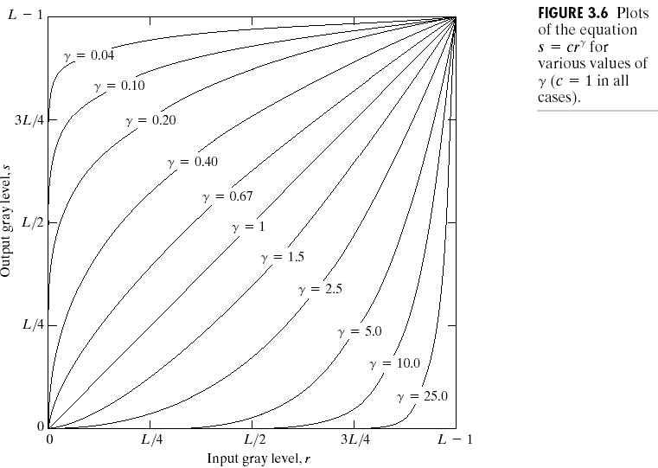
Image Enhancement in the
Spatial Domain
γ=c=1: identity

Slide 62
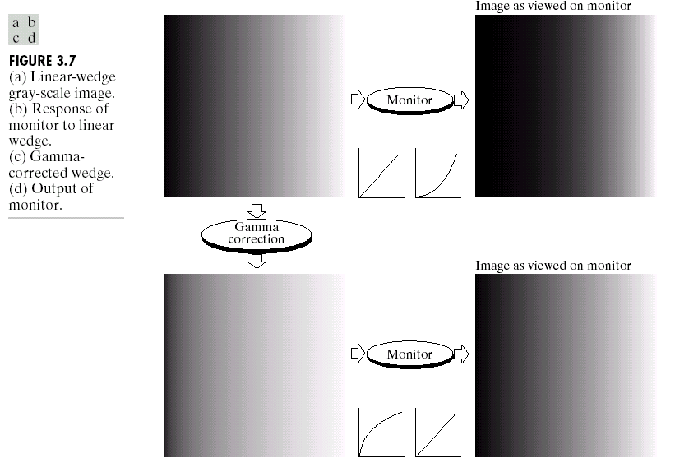
Image Enhancement in the
Spatial Domain

Slide 63
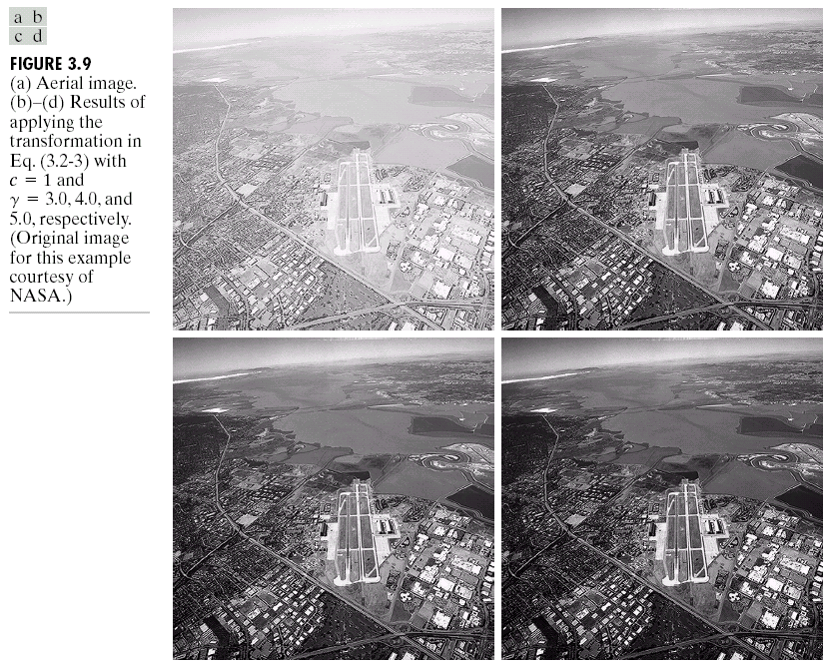
Image Enhancement in the
Spatial Domain

Slide 64
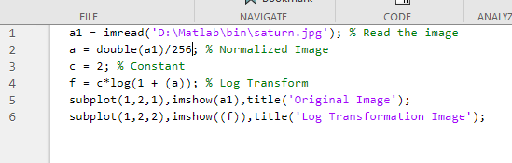

Slide 65
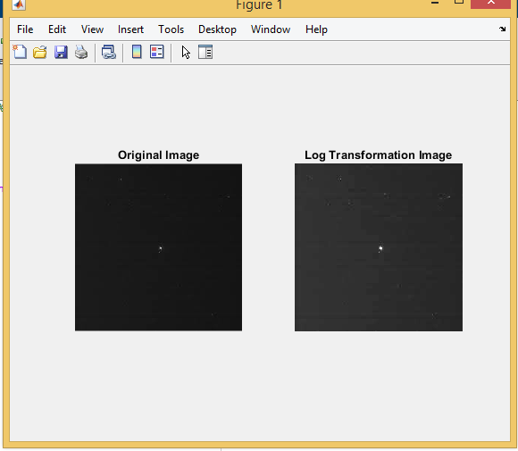

Slide 66


Slide 67


Slide 68
Spatial Domain - Point Processing
7) Power Law Transformation
human perception of brightness - more sensitive to changes in dark as compared to bright.
display devices like computer screen have Intensity to voltage (non linear) - which is a power function with exponents(Gamma) varying from 1.8 to 2.5.
any input signal(say from a camera), the output will be transformed by gamma because of non-linear intensity to voltage relationship of the display screen - This results in images that are darker than intended.

Slide 69

Spatial Domain - Point Processing
we apply gamma correction to the input signal.
This input cancels out the effects generated by the display and we see the image as it is.

Slide 70


Slide 71


Slide 72


Slide 73

Filtering in spatial domain

Slide 74
Neighbourhood Processing
In neighbourhood operation, the pixels in an image are modified based on some function of the pixels in their neighbourhood.
Instead of 3*3 neighbourhood , we could also use 5*5 or a 7*7 …….

Slide 75
Low Pass Averaging Filter (Box Filter)
If an image has Gaussian noise present in it a low pass averaging filter is used to eliminate it.
The mean filter replaces each pixel by the average of all the values in the local neighbourhood.
The size of the neighbourhood controls the amount of filtering.

Slide 76
Low Pass Averaging Filter
spatial averaging operation, each pixel is replaced by a weighted average of its neighbourhood pixels.
The low-pass filter preserves the smooth region in the image and it removes the sharp variations leading to blurring effect.

Slide 77

Low Pass Averaging Filter

Slide 78
Low Pass Averaging Filter
It is to be noted that the sum of the elements is equal to 1 in the case of a low-pass spatial mask.
The blurring effect will be more with the increase in the size of the mask.
the size of the mask will be odd so that the central pixel can be located exactly.

Slide 79


Slide 80


Slide 81
Low Pass Averaging Filter
Low frequency regions remain unchanged while sharp edges become blur.
Grey level transition from 10 to 50 reduces to 10 -23.33 -36.6-50 blurring effect.

Slide 82
Low Pass Averaging Filter
Limitations of Averaging Filter
1. Averaging operation leads to the blurring of an image. Blurring affects feature localisation.
2. If the averaging operation is applied to an image corrupted by impulse noise then the impulse noise is attenuated and diffused but not removed.
3. A single pixel with unrepresentative value can affect the mean value of the centre pixel.

Slide 83

Low Pass Averaging Filter

Slide 84

Weighted Average Filter
The mask of a weighted average filter is given by
the pixels nearest to the centre are weighted more than the distant pixels

Slide 85
Weighted Average Filter
In the mask the pixel at the center of the mask is multiplied by a higher value than any other, thus giving this pixel more importance in the calculation of the average.

Slide 86

Median Filter
Median filters are statistical non linear filters in spatial domain.
Median filter smoothens the image by utilising the median of the neighbourhood.
Steps performed by median filter to find each pixel value in processed image:

Slide 87


Median Filter

Slide 88



Slide 89


Slide 90



Slide 91
Median Filter
When we take the median value, the pixel values which are very different from their neighbouring pixels are replaced by a value equal to the neighbouring pixel value.
median filter is capable of reducing salt-and-pepper noise.
A median filter is an effective tool to minimise salt-and-pepper noise.

Slide 92


Slide 93


Slide 94


Slide 95

Gaussian Filter
Gaussian filters are a class of linear smoothing filters with the weights chosen according to the shape of a Gaussian function.
The Gaussian kernel is widely used for smoothing purpose.
2 Dimensional gaussian function

Slide 96
Gaussian Filter
Gaussian smoothing is a particular class of averaging, in which the kernel is a 2D Gaussian.
Properties of Gaussian Filter:
Gaussian functions are rotationally symmetric in two dimensions. The meaning of the term ‘rotationally symmetric’ is that the amount of smoothing performed by the filter will be the same in all directions.
The Fourier transform of a Gaussian function is itself a Gaussian function. The Fourier transform of a Gaussian has a single lobe in the frequency spectrum. The single lobe in the Fourier transform of a Gaussian means that the smoothened image will not be corrupted by contributions from unwanted high-frequency signals.
The degree of smoothening is governed by variance σ. A larger σ implies a wider Gaussian filter and greater smoothening.

Slide 97


Slide 98
Highpass Filtering
High pass filtering eliminates the low frequency regions while retaining or enhancing the high frequency components.
High pass image will have no background as it’s a low frequency region.
The main aim of image sharpening is to highlight fine details in the image.
Image sharpening is used to enhance the high-frequency components.

Slide 99

Highpass Filtering

Slide 100
Highpass Filtering
Sum of coefficients of high pass mask has to be zero to eliminate the low frequency regions.

Slide 101


Slide 102


Slide 103
High-boost Filtering
High-boost filter is also known as a high-frequency emphasis filter.
A high boost filter is an extension of the high-pass filter, but instead of completely removing the low-frequency components, it retains some portion of the original image while amplifying the high-frequency details.
In high-boost filtering, the input image f(m, n) is multiplied by an amplification factor A before subtracting the low-pass image.

Slide 104


High-boost Filtering
High Boost Image = A(original image) – LPF image
= (A-1)original image + original image – LPF
= (A-1)original image + HPF image

Slide 105

High-boost Filtering

Slide 106


Adjusting the amplification factor A allows you to control the degree of sharpening applied to the image. Lower values result in gentler enhancement, while higher values can produce more pronounced sharpening effects.

Slide 107
Zooming
Zooming simply means enlarging a picture in a sense that the details in the image became more visible and clear. Zooming an image has many wide applications ranging from zooming through a camera lens, to zoom an image on internet e.t.c.

Slide 108


For example
is zoomed into

Slide 109
Optical Zoom vs digital Zoom
Optical Zoom:
The optical zoom is achieved using the movement of the lens of your camera.
The result of the optical zoom is far better then that of digital zoom.
In optical zoom, an image is magnified by the lens in such a way that the objects in the image appear to be closer to the camera.
In optical zoom the lens is physically extended to zoom or magnify an object.

Slide 110
Optical Zoom vs digital Zoom
Digital Zoom:
Digital zoom is basically image processing within a camera.
During a digital zoom, the pixels got expand , due to which the quality of the image is compromised.
The same effect of digital zoom can be seen after the image is taken through your computer by using an image processing toolbox / software, such as Photoshop.

Slide 111
Image Zooming
The zoom process can be done in numerous ways:
Zero Order Hold.
First Order Hold.
Convolution.

Slide 112


Slide 113


Slide 114





Slide 115



Slide 116


1/4(0) +1/2(0) +1/4(0) +1/2(3) +1(0) +1/2(5) + 1/4(0) +1/2(0) +1/4(0) =4

Slide 117
Why we use this convolution method when it require, so many more calculation than the basic averaging of the neighbors method?
The answer :is that many computer boards can perform convolution in hardware, which is generally very fast, typically much faster than applying a faster algorithm in software.

Slide 118

Not only first-order hold be performed via convolution, but zeroorder hold can also achieved by extending the image with zeros and using the following convolution mask.

Slide 119
Note: These methods will only allows us to enlarge an image by a factor of (2N-1), but what if we want to enlarge an image by something other than a factor of (2N-1)?
To do this we need to apply a more general method. We take two adjacent values and linearly interpolate more than one value between them.
This is done by defining an enlargement number k and then following this process:
1. Get the difference between two adjacent values.
2. Divide the result by k.
3. Add the result to the smaller value, and keep adding the result from the second step in a running total until all (k-1) intermediate pixel locations are filled.

Slide 120



Slide 121
Histogram Modelling
Histogram of images provides global description of the appearance of an image.
Histogram of an image represents the relative frequency of occurrence of the various grey levels in an image.

Slide 122

Histogram Modelling
Two methods of plotting histogram.

Slide 123

Histogram Modelling

Slide 124
Histogram Modelling
Histogram plotted in the second method is normalised histogram.
Maximum value to be plotted will be 1.
Normalised histogram provides clear information about the image.

Slide 125
Linear Stretching
Histogram stretching is one way to increase dynamic range of the image.
Here the basic shape of the histogram is not altered , instead the histogram is spread to cover the entire dynamic range.
This enhances the contrast in the image with light toned areas appearing lighter and dark areas appearing darker, making visual interpretation much easier.

Slide 126




Slide 127





$$S=T\left(r\right)=\frac{s_{max}−s_{min}}{r_{max}−r_{min}}\left(r−r_{min}\right)+s_{min}$$
$s_{max}$= Maximum grey level of output image
$s_{min}$= Minimum grey level of output image
$r_{max}$= Maximum grey level of input image
$r_{min}$= Minimum grey level of input image

Slide 128
Histogram Equalization
Equalisation is a process that attempts to spread out the gray levels in an image so that they are evenly distributed across their range.
Histogram equalisation reassigns the brightness values of pixels based on the image histogram.
Histogram equalisation is a technique where the histogram of the resultant image is as flat as possible.

Slide 129

Histogram Equalization
Histogram equalisation provides more visually pleasing results across a wider range of images.

Slide 130


Slide 131


Slide 132


Slide 133


Slide 134


Slide 135


Slide 136


Slide 137


